Slide 1
Performance Management and Appraisal
Part 3 | Training and Development
Chapter 9

Slide 2

After studying this chapter, you should be able to:
Evaluate and improve the appraisal form in Figure 9–1.
Describe the appraisal process.
Develop, evaluate, and administer at least four performance appraisal tools.
Explain and illustrate the problems to avoid in appraising performance.
List and discuss the pros and cons of six appraisal methods.
Perform an effective appraisal interview.
Discuss the pros and cons of using different raters to appraise a person’s performance.

Slide 3



Basic Concepts in Performance
Management and Appraisal
Comparing
Performance Appraisal and
Performance Management
Performance Appraisal:
Setting work standards, assessing performance, and providing feedback to employees to motivate, correct, and continue their performance.
Performance Management:
An integrated approach to ensuring that an employee’s performance supports and contributes to the organization’s strategic aims.

Slide 4
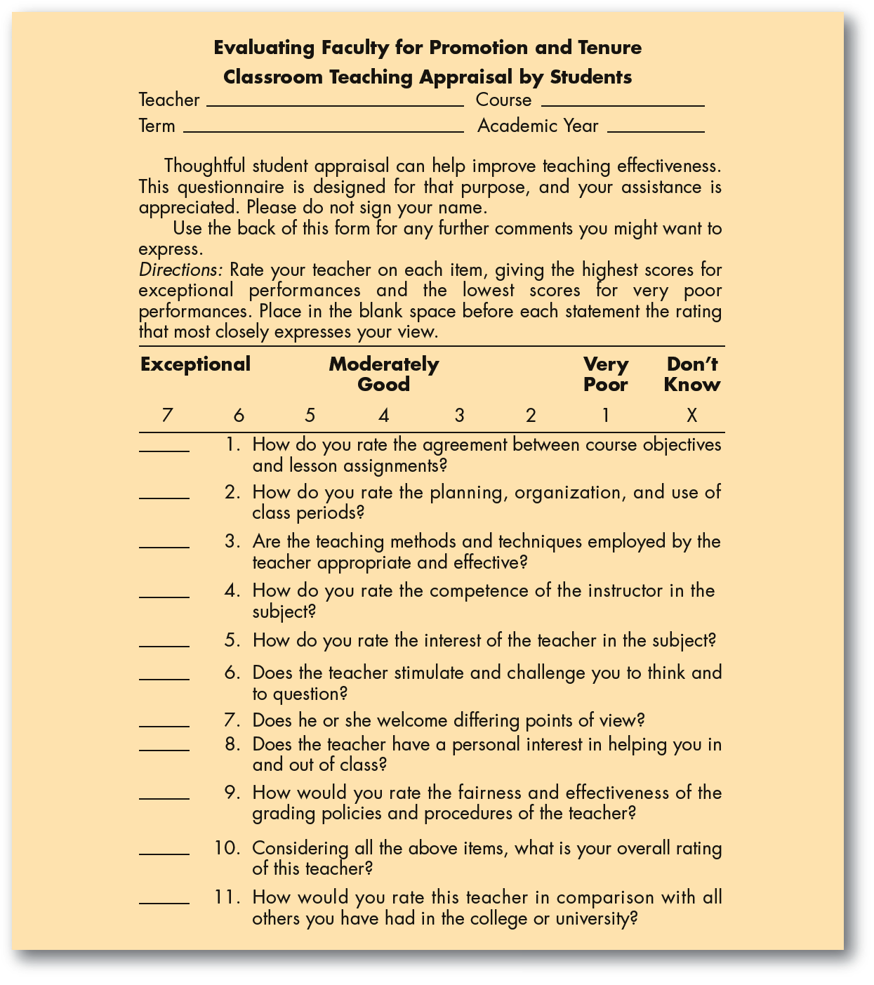
FIGURE 9–1
Classroom Teaching
Appraisal by
Students
Source: Richard I. Miller, Evaluating Faculty for Promotion and Tenure (San Francisco: Jossey-Bass Publishers, 1987), p. 164–165. © 1987, Jossey-Bass Inc., Publishers. All rights reserved. Reprinted with permission of John Wiley & Sons, Inc.

Slide 5

Why Performance Management?
Total Quality
The Performance Management Approach
Appraisal Issues
Strategic Focus

Slide 6

FIGURE 9–2 The Building Blocks of an Effective Performance Management Process
Direction sharing
Role clarification
Goal setting and planning
Goal alignment
Developmental goal setting
Ongoing performance monitoring
Ongoing feedback
Coaching and support
Performance assessment (appraisal)
Rewards, recognition, and compensation
Workflow, process control, and return on investment management

Slide 7

Defining the Employee’s Goals and Work Standards
Guidelines for Effective Goal Setting
Assign Specific Goals
Assign Measurable Goals
Assign Challenging but Doable Goals
Encourage Participation

Slide 8
Setting Goals
SMART Goals:
  Specific, and clearly state the desired results.
  Measurable in answering “how much.”
  Attainable, and not too tough or too easy.
  Relevant to what’s to be achieved.
  Timely in reflecting deadlines and milestones.

Slide 9

Performance Appraisal Roles
Supervisors
  Usually do the actual appraising.
  Must be familiar with basic appraisal techniques.
  Must understand and avoid problems that can cripple appraisals.
  Must know how to conduct appraisals fairly.

Slide 10
Performance Appraisal Roles (cont’d)
The HR Department
  Serves a policy-making and advisory role.
  Provides advice and assistance regarding the appraisal tool to use.
  Trains supervisors to improve their appraisal skills.
  Monitors the appraisal system effectiveness and compliance with EEO laws.

Slide 11
An Introduction to Appraising Performance
Why Appraise Performance?
1
Is basis for pay and promotion decisions.
2
Plays an integral role in performance management.
3
Helps in correcting deficiencies and reinforcing good performance.
4
Is useful in career planning.

Slide 12
(Un)Realistic Appraisals
Motivations for Soft Appraisals
  The fear of having to hire and train someone new.
  The unpleasant reaction of the appraisee.
  An appraisal process that’s not conducive to candor.
Hazards of Soft Appraisals
  Employee loses the chance to improve before being forced to change jobs.
  Lawsuits arising from dismissals involving inaccurate performance appraisals.

Slide 13

An Introduction to Appraising Performance
Steps in Appraising Performance
1
Defining the job
2
Appraising performance
3
Providing feedback

Slide 14
Designing the Appraisal Tool
What to Measure?
  Work output (quality and quantity)
  Personal competencies
  Goal (objective) achievement
How to Measure?
  Generic dimensions
  Actual job duties
  Behavioral competencies

Slide 15
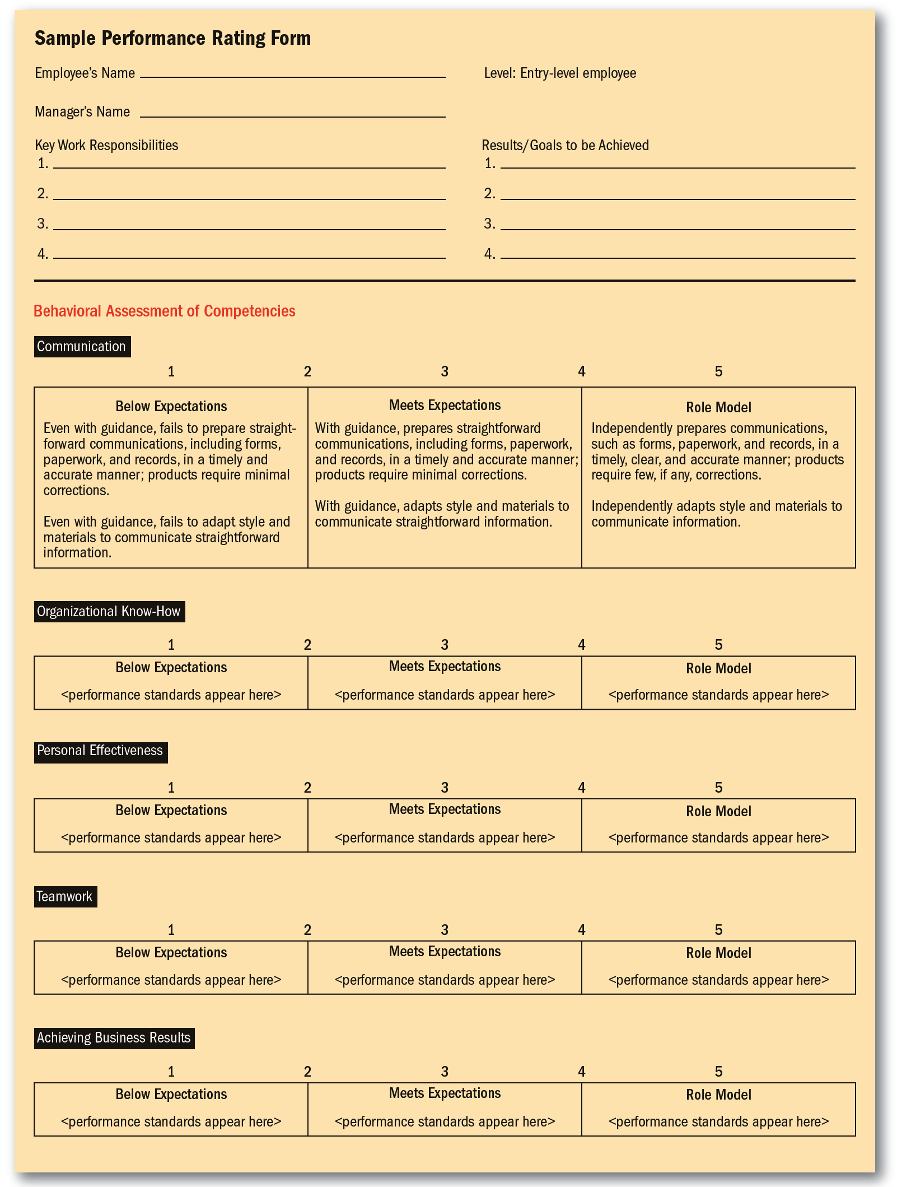
FIGURE 9–3
Sample Performance Rating Form
Source: Elaine Pulakos, Performance Management (SHRM Foundation, 2004) p. 16–17.
Reprinted by permission of Society for Human Resource
Management via Copyright Clearance Center.

Slide 16
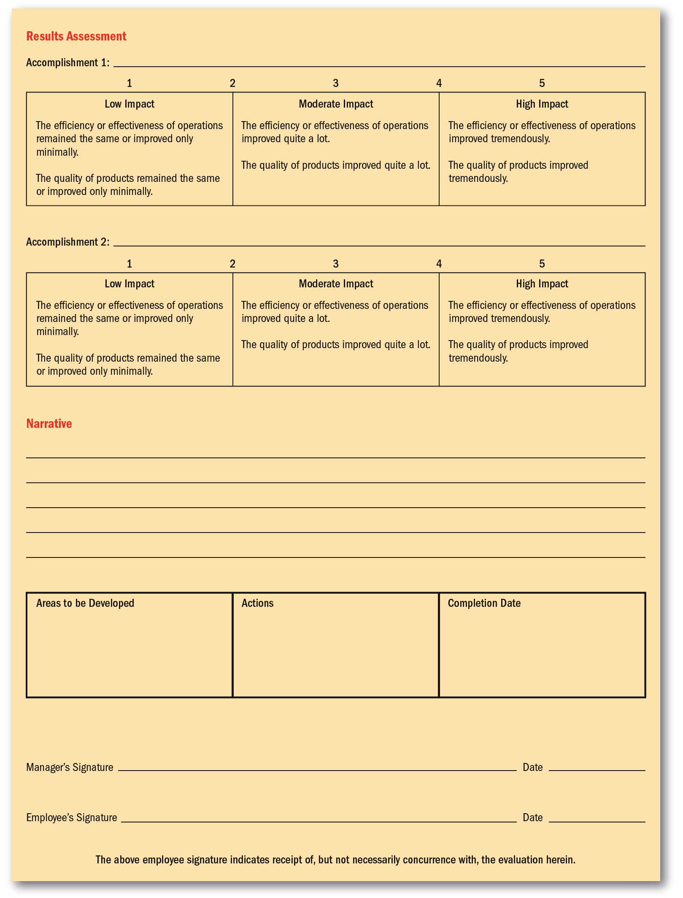
FIGURE 9–3
Sample Performance Rating Form (cont’d)
Source: Elaine Pulakos, Performance Management (SHRM Foundation, 2004) p. 16–17.

Slide 17
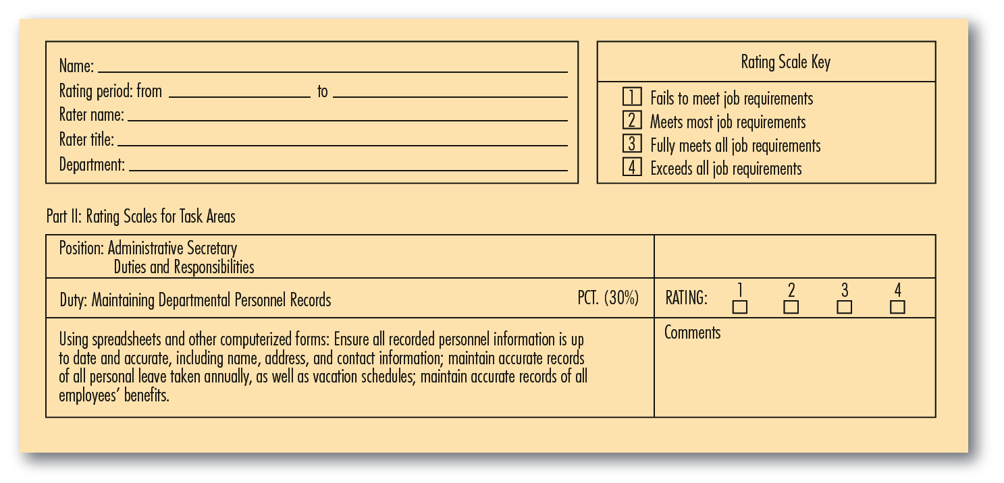
FIGURE 9–4 Portion of an Administrative Secretary’s Performance Appraisal Form Showing Task(s) to Appraise

Slide 18
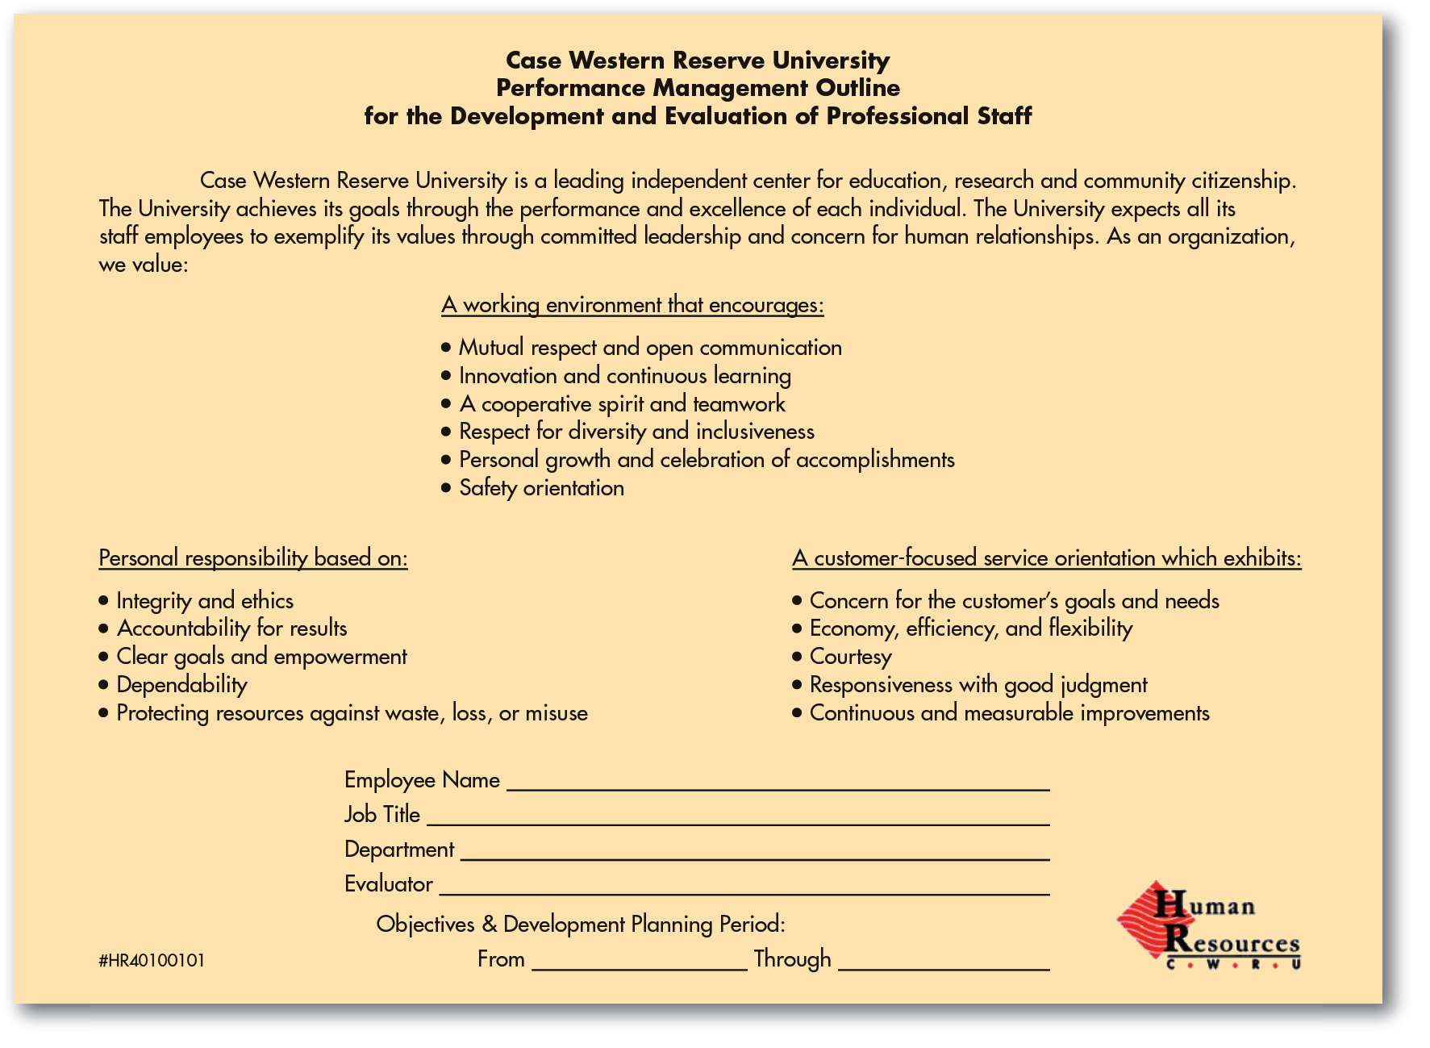
FIGURE 9–5 Appraisal Form for Assessing Both Competencies and Specific Objectives
Source: http://www.case.edu/finadmin/humres/policies/perfExempt.pdf. Accessed May 17, 2007.

Slide 19
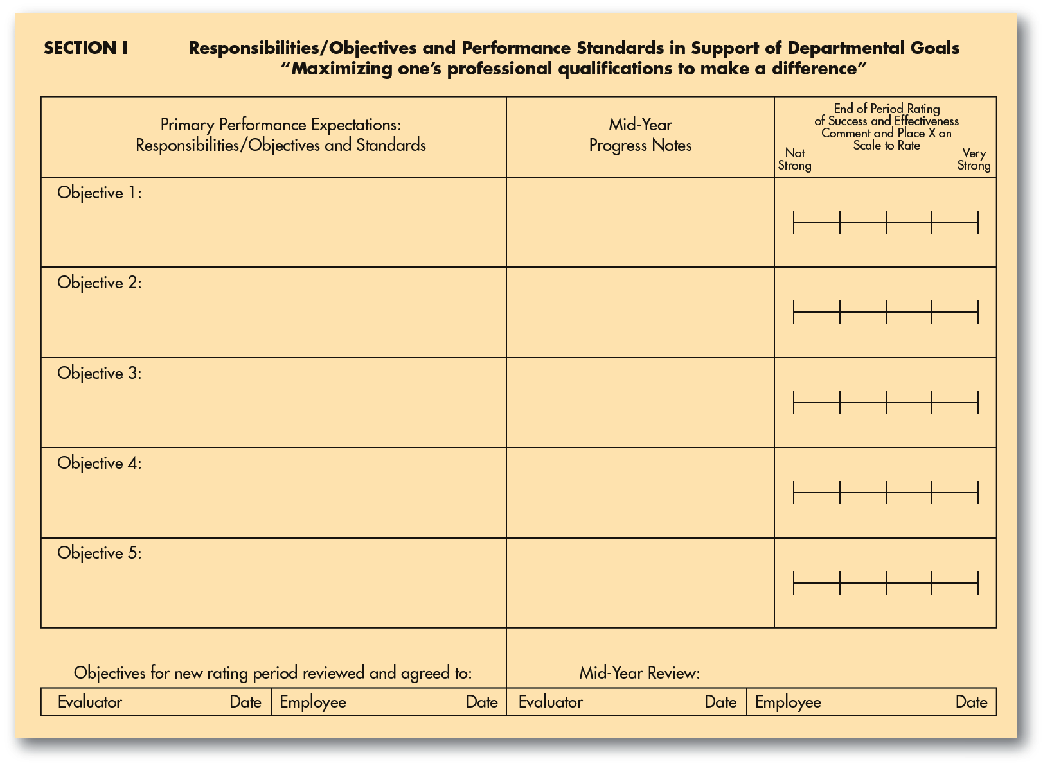
FIGURE 9–5 (continued)
Source: http://www.case.edu/finadmin/humres/policies/perfExempt.pdf. Accessed May 17, 2007.

Slide 20
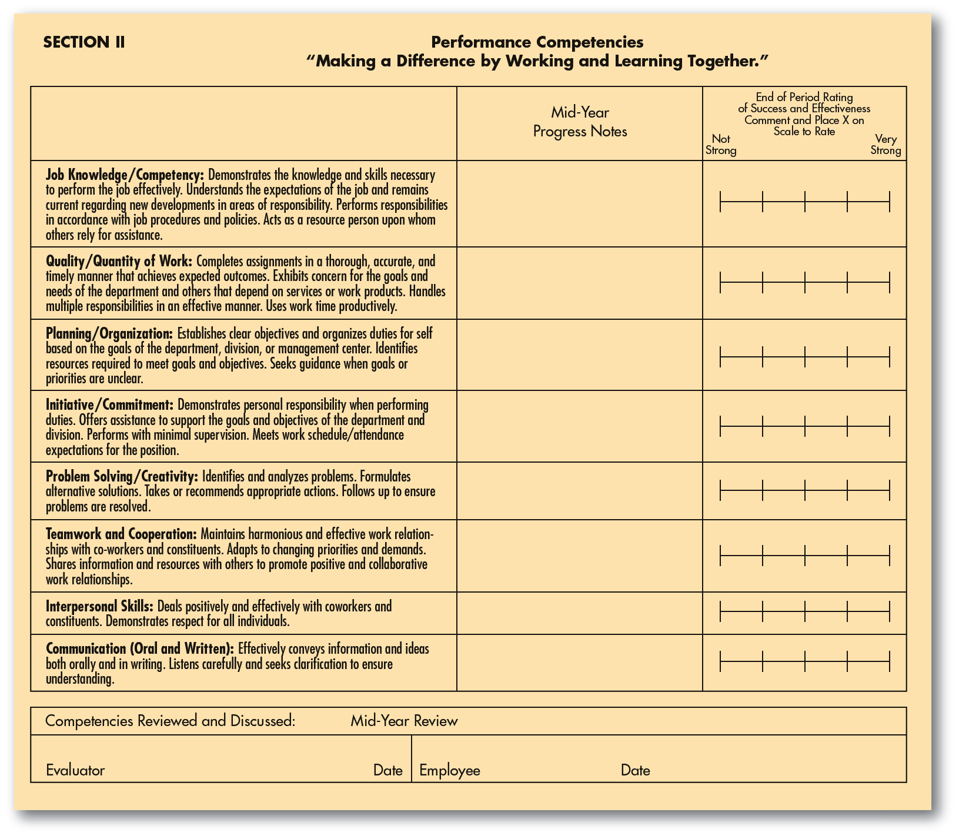
FIGURE 9–5 (continued)
Source: http://www.case.edu/finadmin/humres/policies/perfExempt.pdf. Accessed May 17, 2007.

Slide 21
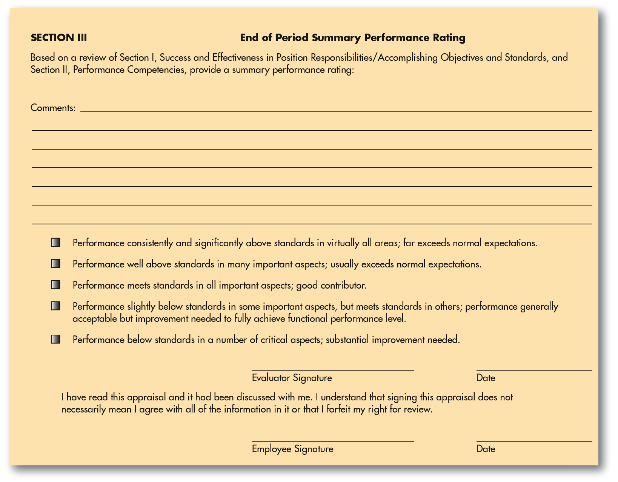
FIGURE 9–5 (continued)
Source: http://www.case.edu/finadmin/humres/policies/perfExempt.pdf. Accessed May 17, 2007.

Slide 22
Performance Appraisal Methods
Appraisal Methodologies
1
Graphic Rating Scale Method
6
Narrative Forms
2
Alternation Ranking Method
7
Behaviorally Anchored Rating Scales (BARS)
3
Paired Comparison Method
8
Management by Objectives (MBO)
4
Forced Distribution Method
9
Computerized and Web-Based Performance Appraisal
5
Critical Incident Method
10
Merged Methods

Slide 23
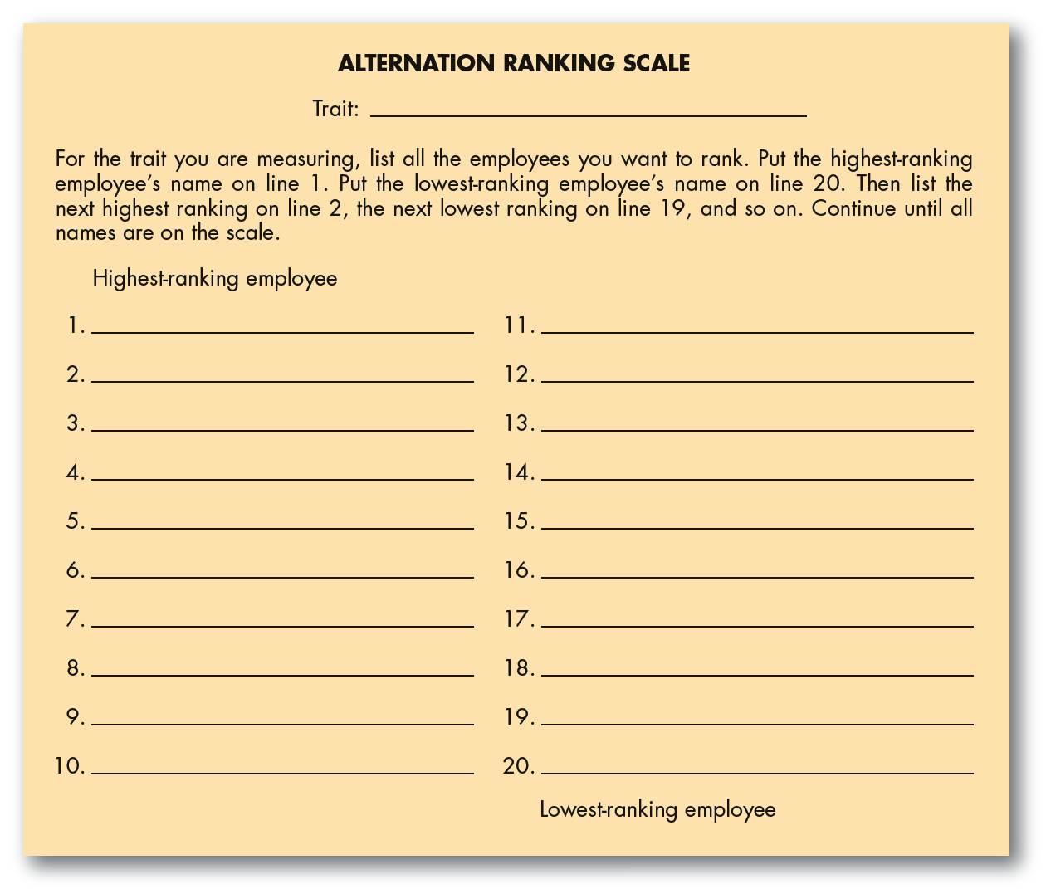
FIGURE 9–6 Scale for Alternate Ranking of Appraisees

Slide 24
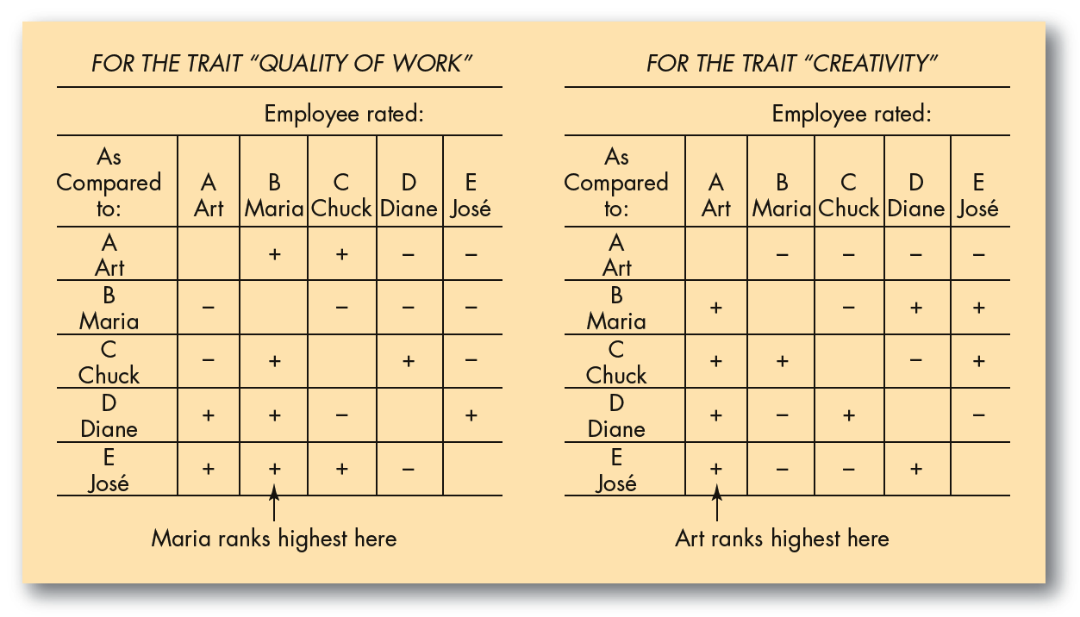
FIGURE 9–7 Ranking Employees by the Paired Comparison Method
Note: + means “better than.” – means “worse than.” For each chart, add up the number of +’s in each column to get the highest-ranked employee.

Slide 25
TABLE 9–1 Examples of Critical Incidents for a Plant Manager
Continuing Duties | Targets | Critical Incidents
Schedule production for plant | 90% utilization of personnel and machinery in plant; orders delivered on time | Instituted new production scheduling system; decreased late orders by 10% last month; increased machine utilization in plant by 20% last month
Supervise procurement of raw materials and inventory control | Minimize inventory costs while keeping adequate supplies on hand | Let inventory storage costs rise 15% last month; overordered parts “A” and “B” by 20%; underordered part “C” by 30%
Supervise machinery maintenance | No shutdowns due to faulty machinery | Instituted new preventative maintenance system for plant; prevented a machine breakdown by discovering faulty part

Slide 26
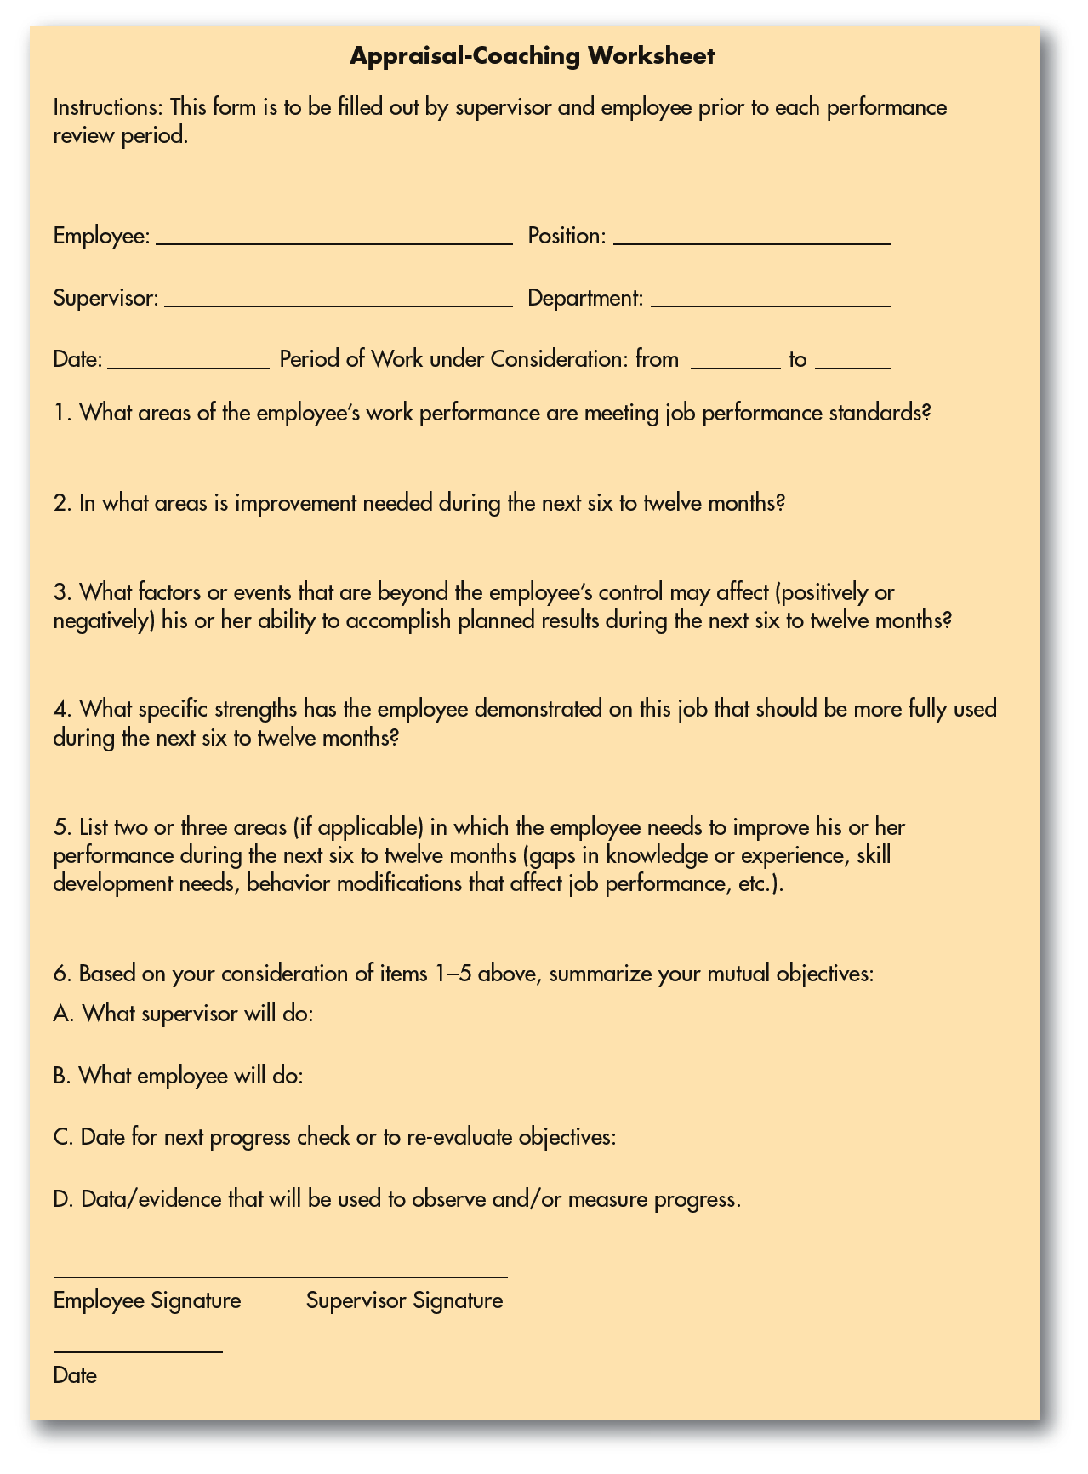
FIGURE 9–8
Appraisal-Coaching
Worksheet
Source: Reprinted from www.HR.BLR.com with permission of the publisher Business and Legal Reports, Inc. 141 Mill Rock Road East, Old Saybrook, CT © 2004.

Slide 27
Behaviorally Anchored Rating Scale (BARS)
Developing a BARS
  Generate critical incidents
  Develop performance dimensions
  Reallocate incidents
  Scale the incidents
  Develop a final instrument
Advantages of BARS
  A more accurate gauge
  Clearer standards
  Feedback
  Independent dimensions
  Consistency

Slide 28
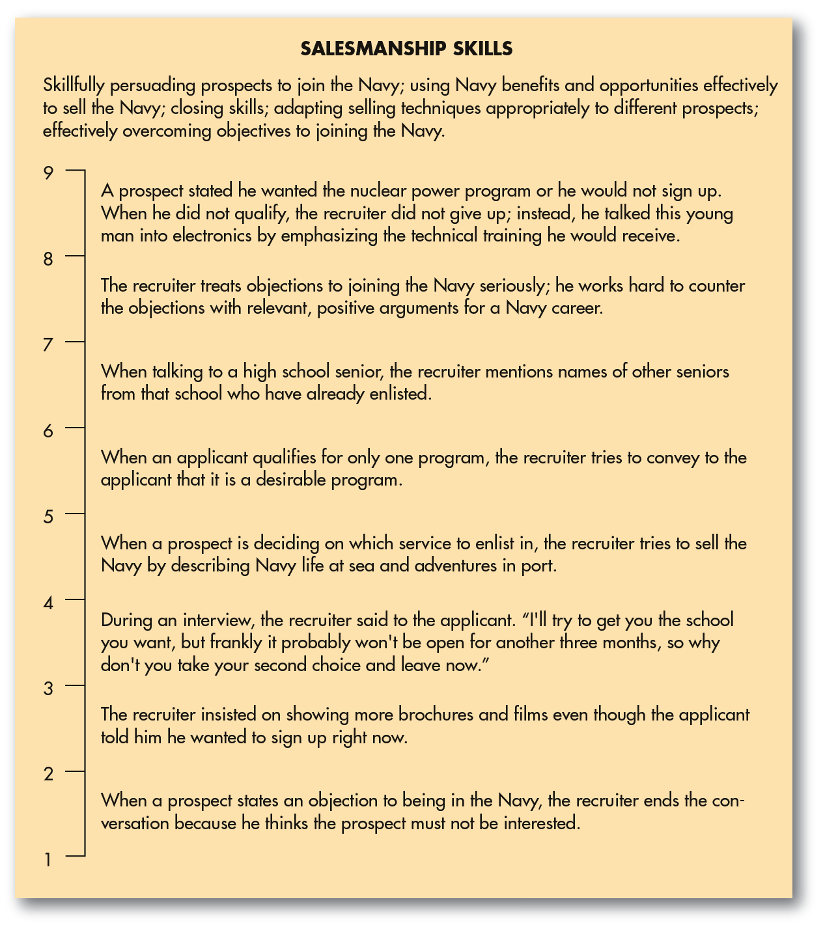
FIGURE 9–9
Example of a
Behaviorally
Anchored Rating
Scale for the
Dimension
Salesmanship Skills

Slide 29
Management by Objectives (MBO)
A comprehensive and formal organizationwide goal-setting and appraisal program requiring:
  Setting of organization’s goals.
  Setting of departmental goals.
  Discussion of departmental goals.
  Defining expected results (setting individual goals).
  Conducting periodic performance reviews.
  Providing performance feedback.

Slide 30
Using MBO
Setting unclear objectives
Time-consuming appraisal process
Problems with MBO
Conflict with subordinates over objectives

Slide 31
Appraising Performance: Problems and Solutions
Potential Rating Scale Appraisal Problems
Unclear Standards
Halo
Effect
Central Tendency
Leniency or Strictness
Bias

Slide 32
TABLE 9–2 A Graphic Rating Scale with Unclear Standards
 | Excellent | Good | Fair | Poor
Quality of work
Quantity of work
Creativity
Integrity
Note: For example, what exactly is meant by “good,” “quantity of work,” and so forth?

Slide 33
FIGURE 9–10 Sample Rating Errors
Focusing on one or two critical incidents
Lower rating for less challenge
Nobody can be that good (Strictness)
Similarity
Being influenced by prior performance
Rating for retention
Style differences
Emotional rating
Recent performance only
Friendships

Slide 34
Appraising Performance:
Problems and Solutions (cont’d)
How to Avoid Appraisal Problems
Know Problems
Use the
Right Tool
Train Supervisors
Control Outside Influences
Keep
a Diary

Slide 35
TABLE 9–3 Important Advantages and Disadvantages of Appraisal Tools
Tool | Advantages | Disadvantages
Graphic rating scale | Simple to use; provides a quantitative rating for each employee. | Standards may be unclear; halo effect, central tendency, leniency, bias can also be problems.
BARS | Provides behavioral “anchors.” BARS is very accurate. | Difficult to develop.
Alternation ranking | Simple to use (but not as simple as graphic rating scales). Avoids central tendency and other problems of rating scales. | Can cause disagreements among employees and may be unfair if all employees are, in fact, excellent.
Forced distribution method | End up with a predetermined number or % of people in each group. | Employees’ appraisal results depend on your choice of cutoff points.
Critical incident method | Helps specify what is “right” and “wrong” about the employee’s performance; forces supervisor to evaluate subordinates on an ongoing basis. | Difficult to rate or rank employees relative to one another.
MBO | Tied to jointly agreed-upon performance objectives. | Time-consuming.

Slide 36
Who Should Do the Appraising?
Immediate Supervisor
Self-Rating
Potential Appraisers
Peers
Subordinates
Rating
Committee
360-Degree
Feedback

Slide 37
The Appraisal Interview
Satisfactory—Promotable
Satisfactory—Not Promotable
Types of Appraisal
Interviews
Unsatisfactory—Correctable
Unsatisfactory—Uncorrectable

Slide 38
The Appraisal Interview (cont’d)
Guidelines for Conducting an Interview
Talk in terms of objective work data.
Don’t get personal.
Encourage the person to talk.
Don’t tiptoe around.

Slide 39
The Appraisal Interview (cont’d)
How to Handle a Defensive Subordinate
1
Recognize that defensive behavior is normal.
2
Never attack a person’s defenses.
3
Postpone action.
4
Recognize your own limitations.

Slide 40
The Appraisal Interview (cont’d)
How to Criticize a Subordinate
1
Do it in a manner that lets the person maintain his or her dignity and sense of worth.
2
Criticize in private, and do it constructively.
3
Give daily feedback so that the review has no surprises.
4
Never say the person is “always” wrong.
5
Criticism should be objective and free of biases.

Slide 41
The Appraisal Interview (cont’d)
How to Ensure Improved Performance
1
Don’t make the subordinate feel threatened during the interview.
2
Give the subordinate the opportunity to present his or her ideas and feelings.
3
Give daily feedback so that the review has no surprises.
4
Never say the person is “always” wrong.
5
Criticism should be objective and free of biases.

Slide 42
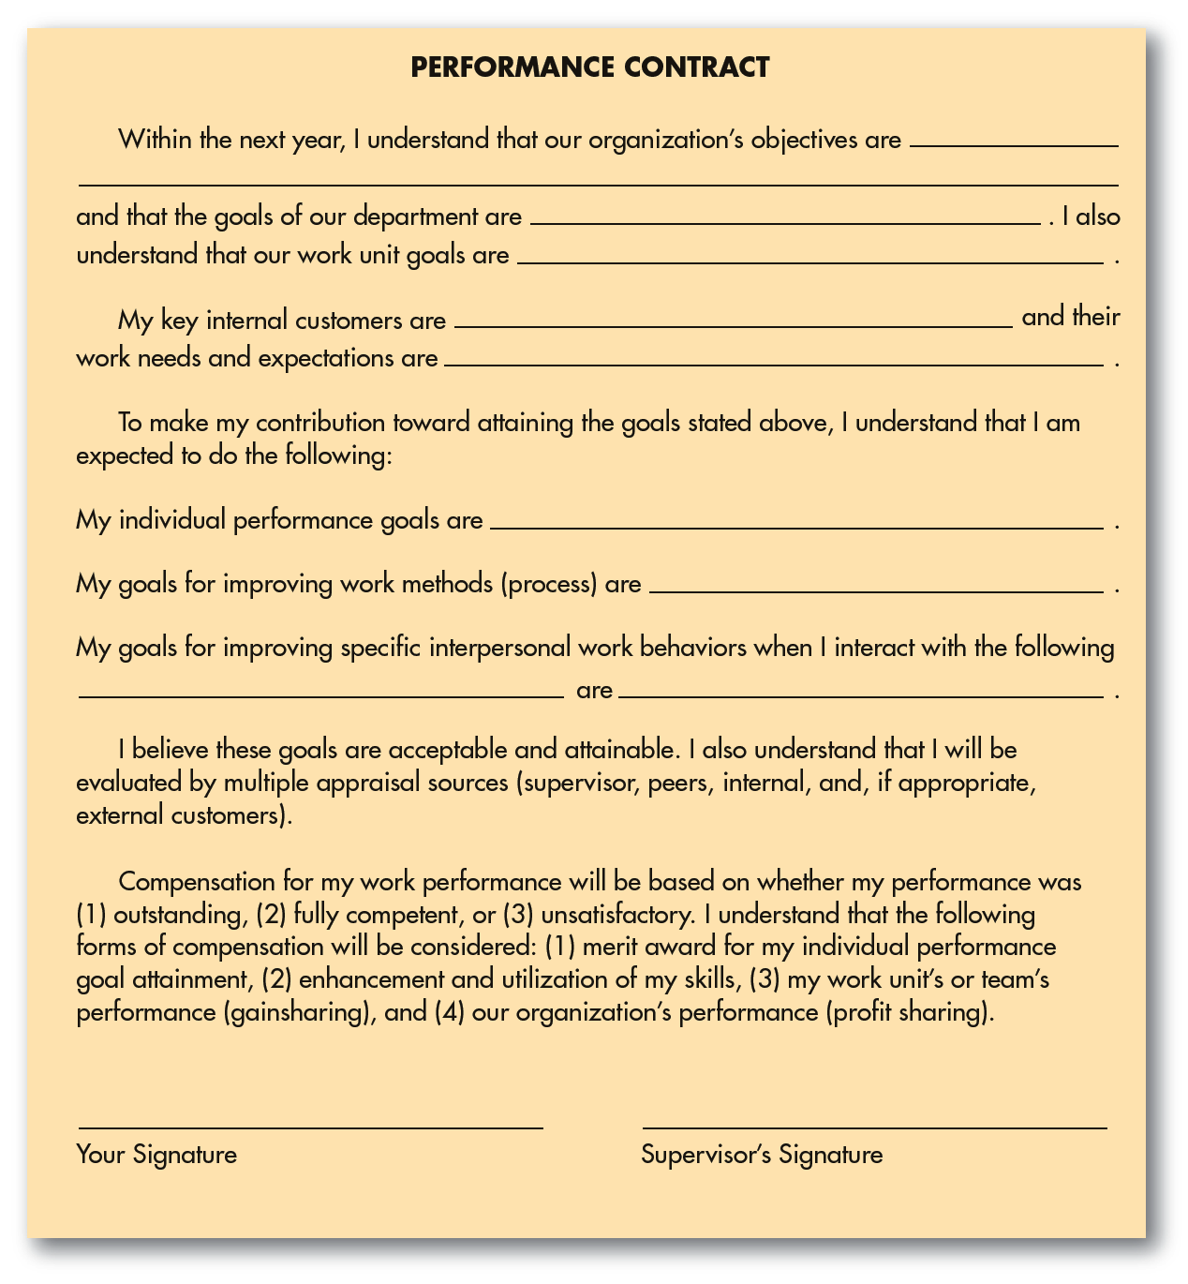
FIGURE 9–11
Performance
Contract
Source: David Antonion, “Improving the Performance Management Process Before Discontinuing Performance Appraisals,” Compensation and Benefits Review May–June 1994, p. 33, 34.
Reprinted by permission of
Sage Publications, Inc.

Slide 43
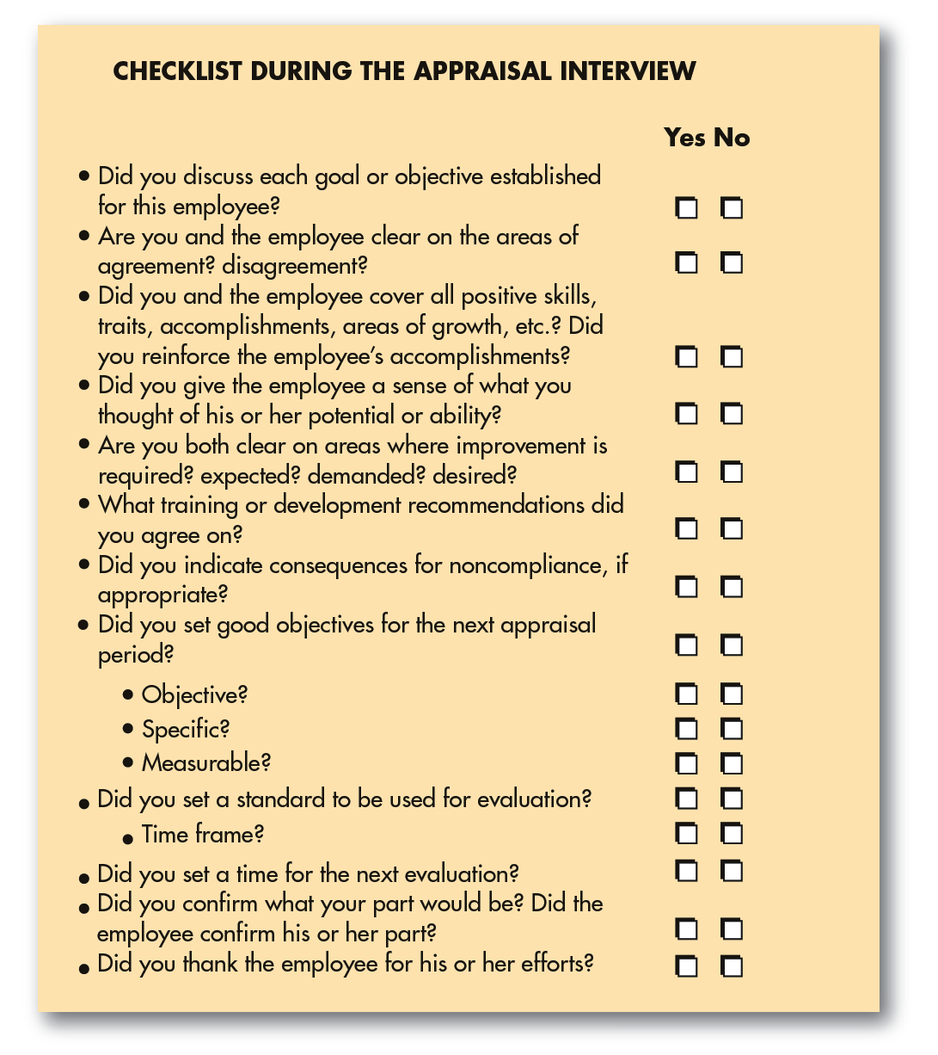
FIGURE 9–12
Checklist During the
Appraisal Interview

Slide 44
Formal Written Warnings
Purposes of a Written Warning
  To shake your employee out of bad habits.
  To help you defend your rating, both to your own boss and (if needed) to the courts.
A Written Warning Should:
  Identify standards by which employee is judged.
  Make clear that employee was aware of the standard.
  Specify deficiencies relative to the standard.
  Indicate employee’s prior opportunity for correction.

Slide 45
Creating the Total Performance
Management Process
“What is our strategy and what are our goals?”
“What does this mean for the goals we set for our employees, and for how we train, appraise, promote, and reward them?”

Slide 46
FIGURE 9–13 Information Required for TRW’s Web-Based Performance Management System
Page 1 biographical data
Identification information
Education
Experience summary
Pages 2–3 performance summary
Accomplishments against previous year goals
  TRW behaviors
  TRW initiatives
Legal and ethical conduct/diversity and cultural sensitivity
Previous year’s professional development activities
Employee comments
Overall performance—manager’s overall rating and comments
Page 4 development summary
Demonstrated strengths
Improvement opportunities
Performance goals for the upcoming year
Professional development activities for the upcoming year
Future potential/positions (employee perspective)
Future potential/positions (manager perspective)
Electronic sign-off from both employee and manager
Source: D. Bradford Neary, “Creating a Company-Wide, Online, Performance Management System: A Case Study at TRW, Inc.,” Human Resource Management 41, no. 4 (Winter 2002), p. 495.
Reprinted by permission of
Society for Human Resource
Management via Copyright
Clearance Center.

Slide 47
K E Y T E R M S
performance appraisal
performance management
graphic rating scale
alternation ranking method
paired comparison method
forced distribution method
critical incident method
behaviorally anchored rating scale (BARS)
management by objectives (MBO)
electronic performance monitoring (EPM)
unclear standards
halo effect
central tendency
strictness/leniency
bias
appraisal interview

